Slide 1
React Training Course
Fundamentals of Component based development and advanced concepts

Slide 2
Topics
Clone: https://github.com/flanamacca/react-learning-kit Run: DB_TYPE=“NONE” npm run dev (nix machines)
On windows – need to install nodemon, cross-env globally and then run the npm run dev command independently
Part 1 – Fundamentals
Component Fundamentals – What is the purpose of a component driven system
Component Lifecycle – crumbs of broken dreams
Dom Manipulation and management of Dom Nodes – React, the Shadow Dom and You
Higher Order Components – The candy wrappers of React
Loading and Managing Data in Components– Ensuring your components behave well with data
Part 2 – Structuring an Application
Routing in a Single Page Application
Webpack bundling and splitting - When to split, how to split and how to monitor
Application State Management (Redux) – What Why How of Dispatching, Reducing and Storing
Server Side Rendering / Isomorphic Applications – Working in a server side world
Automated Testing and development with Jest, Storybook and Redux
Source:

Slide 3
Component Fundamentals – Things to know
React is all about discrete building blocks, or components. All components small or big should be reusable, even across different projects.
Uses JSX to combine HTML and Javascript, which is then transpiled into readable ES5 forms for browsers
All React element attributes are in camelCase rather than lower case (to allow React’s own event handler to manage performance)
Properties are immutable. Properties represent how your component was initialized and should never be modified.
State represents how your app changes over time and is expected to change (triggering re-render)
The React Shadow Dom tracks previous renders vs current renders to determine if the output has changed (and then compute these changes into Dom operations)

Slide 4
Component Fundamentals – What should I think about
Should I even make it a component?
- Wrapping anything in React adds additional load and code to running it. Wrapping HTML element is often overkill – think about what component lifecycle and properties you want and need
Does my component require data to be loaded? Is this data shared between multiple components?
- Passing properties between components (especially parent to child)
What is the minimum amount of properties my component needs to function
- Passing large objects down the tree stack adds a lot of overhead. This can come in the form of type requirements, extra processing and unnecessary complexity. A component should ONLY deal with the data it needs

Slide 5
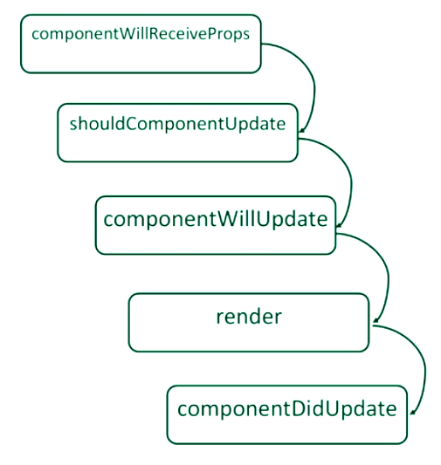
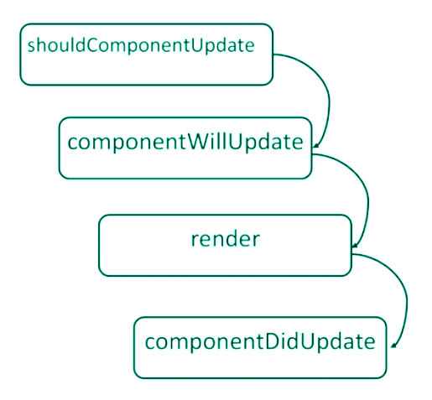
Component Lifecycle Management
componentWillMount() {
// Triggered before any rendering takes place – good time to initialize data loading. (NOTE – This function is called when Server Side Rendering)
}
componentDidMount() {
// Called once the component has completed rendering and the DOM is available here
}
componentWillUnmount() {
// Cleanup function – Destroy listeners, refs, objects in memory etc
}

Slide 6
Component Lifecycle Management - What When Where - HOW
Components will re-render whenever the properties passed to them changes, or the internal state of a component is modified.
If either the state object or the passed-in props are changed, React has an important decision to do. Should the component be updated in the DOM? This is why it invokes another important lifecycle method here, shouldComponentUpdate. This method is an actual question, so if you need to customize or optimize the render process on your own, you have to answer that question by returning either true or false.
If there is no shouldComponentUpdate specified, React runs it’s own “attempt” at this.
To determine the changed output, React invokes componentWillUpdate to determine a true/false value.
If the rendered output is identical, no changes are pushed to the Dom. If there is a difference, React uses it’s Shadow Dom to modify on the browser.
What an update does occur, React will invoke componentDidUpdate.
** Question – what is the different between a shallow compare and a deep compare? Which does React use by default? Why does this matter?

Slide 7
Components – Statefull or Stateless?
“Stateless Components are significantly faster than Statefull Components to mount/unmount and render” - Myth
Also considered a presentational component
Introduced as a design pattern to enable future optimizations.
No smart logic – if any data changes the Stateless Component will re-render.
PureComponent (React 15.3) provides a shallow equal comparison on props to resolve differences and control updates
So should I use stateless components where possible? YES
- Easier to read
- Easier to write
- Easier to manage
- Encourages reuse
- Plenty of performance improvements to come
Optimization: Call your Stateless Components as functions instead of React Components to have them run as dumb functions without any React overhead.
{Component({param: ‘value’})} vs <Component param=‘value’ />

Slide 8
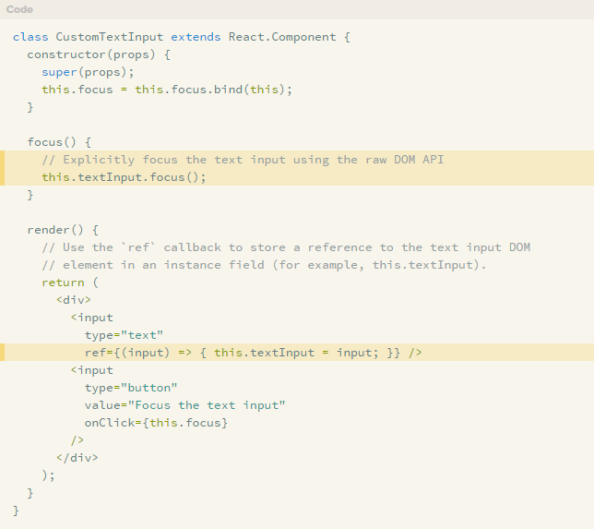
Dom Manipulation
Refs are used to interact with the Dom in React
When you specify a Dom element, you call the “ref” property on the element and provide a function. The function receives a reference to the Dom element
Use cases:
Forms (Getting the value of a field)
Changing the current browser interaction points (scroll to, field focus)
Third party UI libraries (such as jQuery*)
The ref is a pure Dom element (Low level javascript)
* jQuery is usually discouraged with React applications – but is used for things like Bootstrap (ReactStrap is a good example of managing this for you)

Slide 9
Higher Order Functions (HOCs)
A way of extending React Components to provide reusability, extensibility and control
What can we achieve with a HOC?
- Code re-use, logic and bootstrap abstraction
- Modify and hijack the rendering of components
- State abstraction and manipulation
- Property Manipulation
Some popular examples of HOC include
- Redux (connect), which wraps your component with Redux listeners and passes back changes in state as properties
- Redux Form – adds redux listeners and component watchers, to track your fields

Slide 10
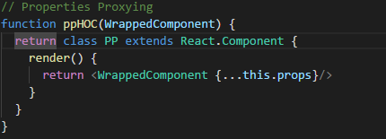
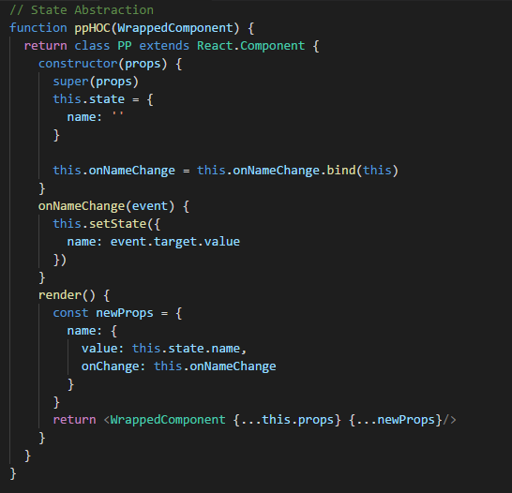
Higher Order Functions (HOCs)
Use Props Proxying
- Can manipulate the properties passed
- Access instance via refs and scope
- Abstract state away from the component
- Wrap the component with other elements or components
Use Inheritance Inversion
- Extends the wrapped component
- Access the wrapper component functions, properties and state from within the child component
- Hijack the rendered output (change props and modify the outputted component properties and element tree)

Slide 11
Data Management – Loading and Managing Data in components
Props are for data that is passed to your component from elsewhere, state is for data that is specific to your component.
Questions you should ask when loading Component data:
How many other components will need access to this data?
Ensure there is a single source of truth for data
Consider “Lifting State Up” – the process of managing data at the closest ancestor to the components that need it
Do I need to access data from an external resource (API) ?
If so, how do I track if the request has been made? Completed? Failed? Errors?
There are two key lifecycle methods that are recommended to initiate lifecycle requests – componentDidMount and componentDidUpdate(). This is because they are aware of properties being changed (props and state)

Slide 12
Component Lifecycle Demonstration
Switching to Agoda React Learning Kit
- Select Component Lifecycle from the front page
- Watch the way the state is being modified and how it impacts on the amount of steps and redraws the component is doing (in the browser console)
Files:
- app/containers/ComponentLifecycle.jsx
- app/components/LifecycleDemoComponent.jsx
TASKS: 10 minutes
- Put a notification on the screen to let us know that the same name has been picked twice in a row.
- Count how many times each name is displayed and display a table listing the results

Slide 13
Higher Order Component Demonstration – Form Management
Switching to Agoda React Learning Kit
- Select Higher Order Component from the front page
- The form wraps the components that render each of the fields and determines
Files:
- app/containers/HOCForm.jsx
- app/components/Form/Field.jsx
- app/components/Form/Input.jsx
TASKS: 20 minutes
- Add two new field types - textarea and select field
- Add error handling to the form (required fields, is numeric) that will add bootstrap error classes (‘has-danger’) to the ‘form-group’ container div
- Add form submission that ensures that there is no errors in the form and outputs the contents of the form to the console. Submit the form to

Slide 14
Data Management - Demonstration
Switching to Agoda React Learning Kit
- Select Data Management from the front page
- Loads 105 records from a local API
Files:
- app/containers/DataManagement.jsx
Questions:
- What is the problem with how I am loading in my data?
- How would you look to improve this going forward?
TASKS: 20 minutes
- Paginate the list of records that are returned from the server (10 per page)
- Show the current page in the search results
- Apply some filtering to the results so that when the user types, the results reflect the filter

Slide 15
Q & A
Thank you !

Slide 17
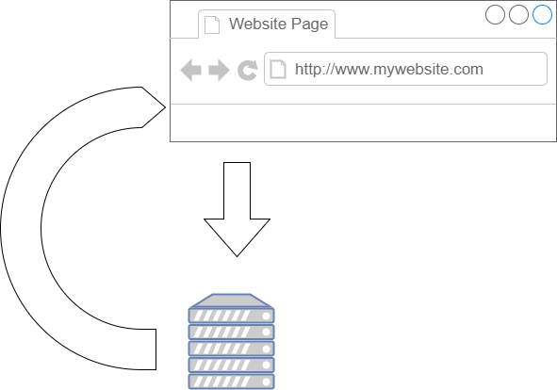
Single Page Application - How does it work?
How do we treat our App as a sequence of pages?
Maybe we want to display different depending on what the user clicks on?
How can we then make these different states accessible directly?
Traditionally, each time the URL changes, we would make a request to the server and load the content for that particular URL. Each new change in the URL, we would have to reload everything from scratch.
What if we could instead load everything once, and allow the user to navigate around without needing to load everything again?

Slide 18
Routing – HTML 5 to the rescue
HTML5 introduced the history.pushState() and history.replaceState() methods, which allow you to add and modify history entries, respectively. These methods work in conjunction with the window.onpopstate event.
- https://developer.mozilla.org/en-US/docs/Web/API/History_API
history.pushState – allows us to modify the location (window.location.href) by adding a new history object, without actually making a request (or even checking if the URL exists!). This takes 3 parameters:
- state object: A set of data being passed to the new state. Serialized JSON object
- title: a title for the state change
- URL: The URL to load into the address bar – can be relative or absolute. MUST be the same origin (domain).
history.replaceState – modifies the current history object (overwrites it) instead of adding to the list.
window.onpopstate is called every time the location bar in the browser is modified (BUT – only by a browser based action such as clicking on the buttons, or calling history.back() or history.forward()).
Since we can programmatically change the address bar AND it won’t request any new data AND we have a means to track each time the address bar is changed – we can build a Single Page Application that spans and covers multiple URLS.

Slide 19
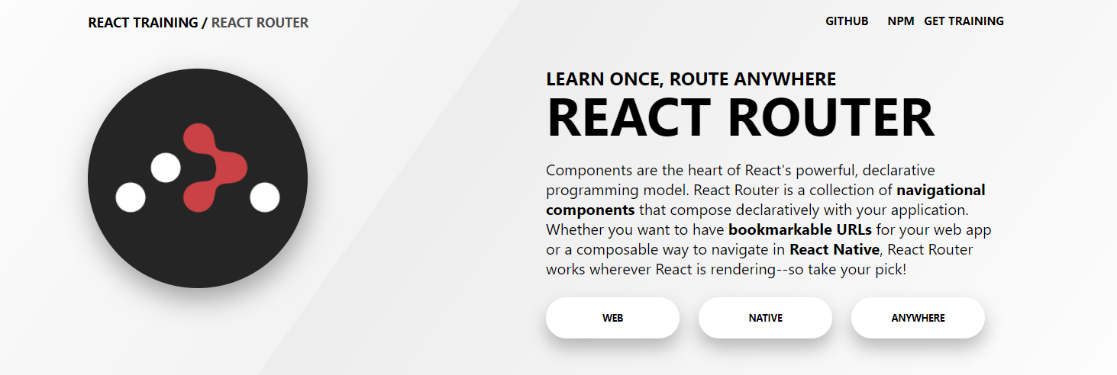
React – Some Options for Routing
React Router Component
React Mini Router
Universal Router
Router 5
React Router
React Router has become one of the most well know routing packages. It supports both React and React Native. (What is one of the key concerns we want to have with component based development? Reusability!)

Slide 20
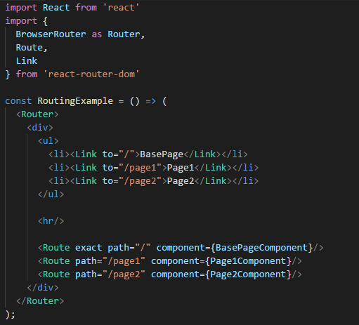
Using React Router v3
Two types of routers: HashRouter and BrowserRouter
- HashRouter uses the hash (window.location.hash) to keep track of your current UI and Page (http://www.mydomain.com.au/something.html#page1) - BrowserRouter uses the HTML5 history API to keep track of your current UI and Page (http://www.mydomain.com.au/something/page1)
Route management is handled through 3 key components.
- The Router manages the area that needs to have bindings to track changes in the current page/URL reference
- The Route manages what to do when a particular page or URL is reached
- The Link allows for control of the application level bindings to track that a page/URL is being changed and fires events to change the page/URL and update the display
NOTE: v4 of React Router is missing some of the features of v3. It offers some great features but is still under active development. v3 is used in the demo code

Slide 21
Webpack Bundle – Splitting and Optimizing
As web applications get larger, the file gets larger too.
- Libraries
- Shared Resources
- Page specific Logic
What about content that is only used on one particular page?
What about code we may want on demand?
How is this achieved?

Slide 22
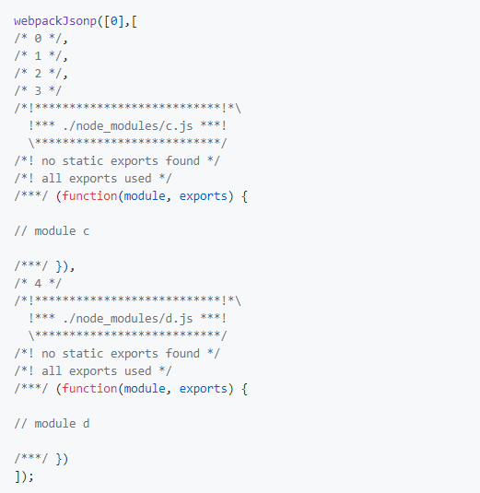
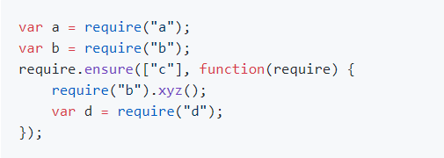
Require.ensure and Import to the rescue!
CommonJS: require.ensure is used to define a split point
ES6 - import('./something/we/want') ** No 100% approval by TC39 (Ecma International, Technical Committee 39) – just the latest proposal
JSONP is used to transfer the chunk file to the web browser from the server.
What happens with this code?

Slide 23
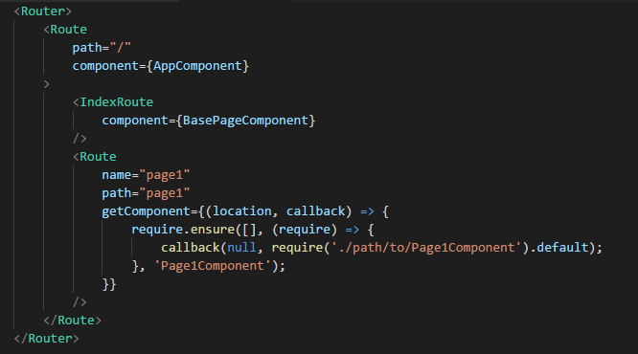
How can this be leveraged in React Router?
In React Router v3, there is support for getComponent property on Routes. This allows us to choose what happens on load and make it asyncronous

Slide 24
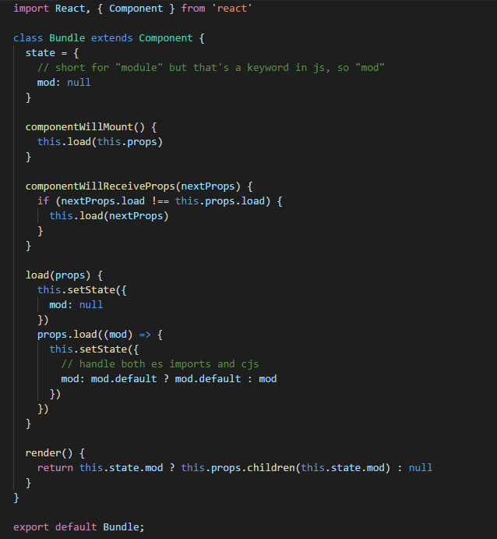
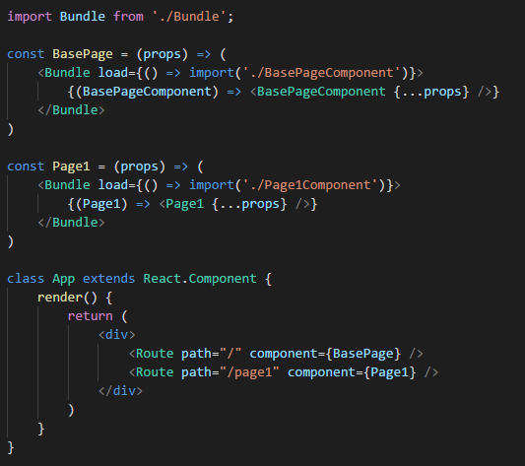
Continued…
In React Router v4, since it only support synchronous component loading, we need to add a wrapper component (Bundle) and wrap it around the expected component that we want.

Slide 25

Application State Management - What is FLUX?

Slide 26
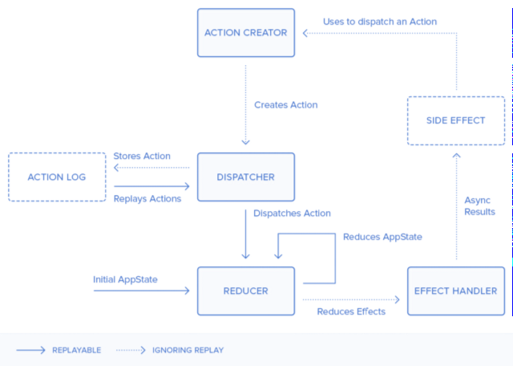
How does Redux extend Flux?

Slide 27
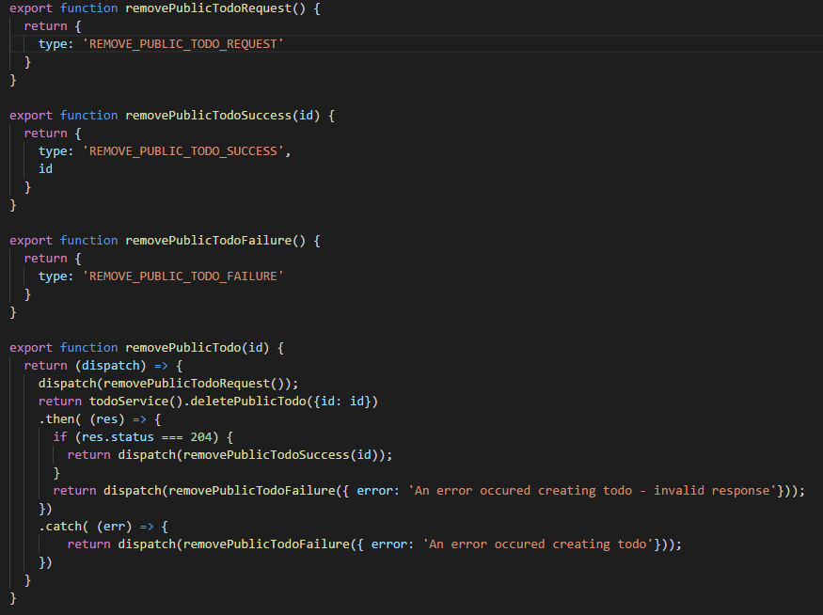
Redux Actions and Messages
All actions in Redux require an identifier (type) for each message that is dispatched.
Use redux-thunk package to allow for asynchronous actions
Use redux-logger package to track actions being emitted and see the previous and new state in your console log
Multiple messages can be dispatched at a time

Slide 28
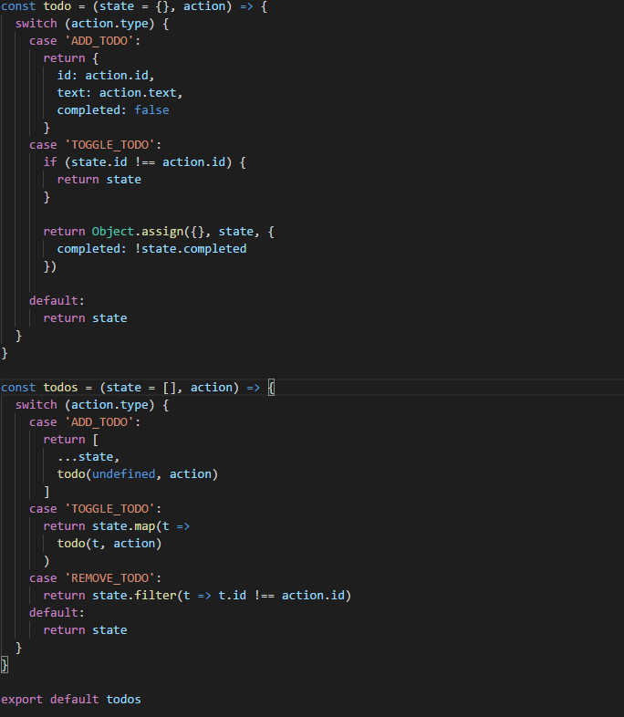
Redux Reducers
Combine Reducers to create an object that tracks into your stores (combineReducers is a redux function that allows you to build up your store.
Reducers take the previous state and allow you to modify the previous state to generate your new application state
Reducers can listen to as many actions as you want
DON’T FORGET: Redux is a Single Store solution.

Slide 29
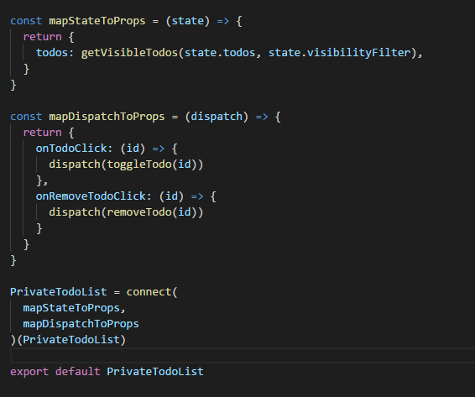
Syncing your Component with Redux
Redux exposes a Higher Order Component called connect which accepts two objects. These objects map the application state (store) to your component and map your component properties to actions (functions).
If you do not map dispatch to properties, you will need to import your actions and wrap dispatch around them manually. This is great for dispatching actions on component mounting or in the constructor.
Every time you update a Redux state, the component itself will trigger componentWillRecieveProps, shouldComponentUpdate, componentWillUpdate and then render.
Only listen to stores that you KNOW your component needs to listen to. If in doubt, use the React Component Lifecycle to filter these out

Slide 30
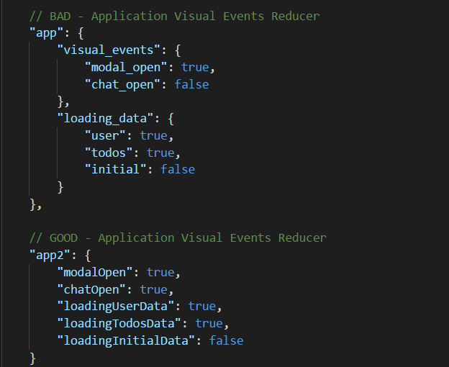
Planning your Application State
Before building your app, it’s a good opportunity to think about what parts of your application need to be made available throughout and exist between various components.
Current user data
Application events that change the display (overlays? Data loading? Activities?)
Data that reflects previous activities or that the user may go back to (Previously viewed items?)
Then think about structure
- Shallow vs Deep comparison
- Grouping by domain gives you an easy way to monitor similar data and keep them localized together

Slide 31
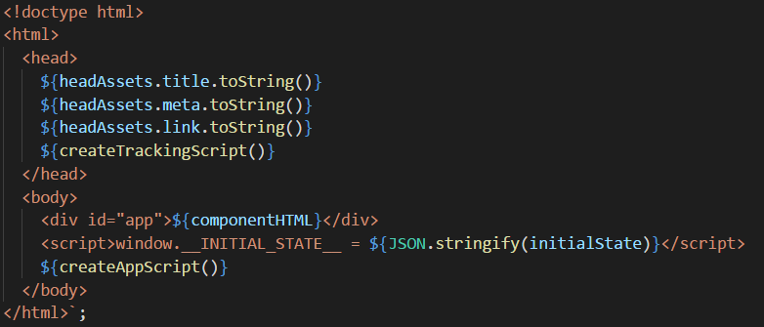
Server Side Rendering / Isomorphic Applications
React is designed for a Client Side focus – why would we want to consider loading things on the server? Gives us the same experience no matter how we use our app!
SEO
Initial Rendering Time on the client
Static Content Generation
React provides 2 such functions out of the box via the ReactDOMServer module
- renderToString: Renders the HTML on the server side, allowing the client side to pickup and use the output. When render() is called, and the HTML is already present React will just attach its event handlers – SUPER performant experience.
- renderToStaticMarkup: Generates just the raw HTML without any attributes added via React (data-reactid etc). Good for generating HTML content for things such as newsletters, emails etc.
Look under server/render to find the middleware to integrate with Redux, React Router and generate this markup

Slide 32


Automated Testing and Development – Storybook and Jest
Storybook provides a framework to not only develop our components and app, but integrate with our test runner and see our components, test our components and confirm via test runners that our components are valid.

Slide 33
Storybook – Interactive Development Environment for components
Key point – a reusable component should be easily findable in your application. Component explorers, like Storybook, allow for easy management and identification of components as well as ensuring documentation is available on how to use them.
Drives the component level focus of components as building blocks. Build one component at a time.
The concept of a ‘story’ in Storybook, is to define the various states that a component may exist in, such as an open state, a selected state, user input being changed.
Support Hot Module Reloading – The ability for updates to your code to be automatically sent to your browser (HMR)
Allows you to list all of your key components and manage their different states for testing.
Integrate with a test runner, such as Jest, to check whether or not your component functions as expected (Check the Dom, check the state of your component, check if properties are changed)
Real time running of tests means ever time you update your code, you see if your tests break
Extensible addon library allowing for documentation (storybook-readme), test runners (specifications), dynamic Jest screenshots (storyshots), realtime screenshots (Screenshot) and more.

Slide 34
Jest – Test Runner
A test runner that allows for use of Enzyme for React component testing and any other javascript testing.
Supports:
- Parallel test running (you got 8 cores? You run 8 tests at once!)
- Code coverage built in (right from the command line)
- Strong mocking (can mock functions, data and more)
- Extensive matchers list (equals, less than, object literals, exceptions, resolutions (promises!) and tracking how many times functions were called).

Slide 35
What goes into writing a good test
Tests are important in ensuring that our code continues to function as expected over time.
To ensure that tests are deterministic, these are the considerations to keep in mind:
Test data randomness (data that a test runs on should contain many variations and possibly be randomized for each instance of execution. Ensure that all scenarios can be covered and specific scenarios can be repeated.
Consider the state of your system before each test. If tests change the state of the system (say, a counter or a string value) and other tests depend on those values it is important that test execution order is maintained. Another option is tear up and tear down (starting values).
Dependence on external systems. If a third party system, object or even component is required, we are assuming that they are working. Our test should account for the fact that these may not be available or working as expected
Documenting the outcomes. For any situation where a test fails, we should be able to narrow down the component/feature/object/service with certainty.
Tests should be deterministic – Success or failure should tell if the system is good or bad with confidence.

Slide 36
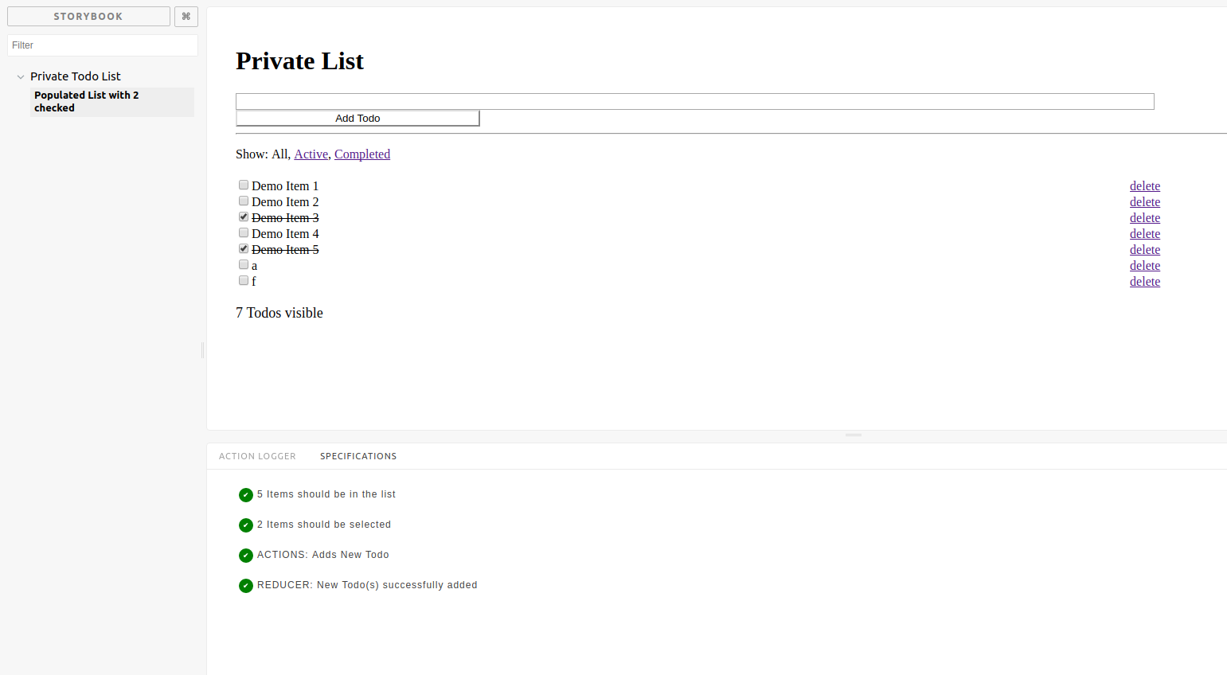
So what does this look like to us as a developer?

